Slide 1
Unit-2: Combinational Logic Circuit
DESIGN PROCEDURE
The design of combinational circuits starts from the specification of the design objective and culminates in a logic circuit diagram or a set of Boolean functions from which the logic diagram can be obtained. The procedure involves the following steps:
1. From the specifications of the circuit, determine the required number of inputs and outputs and assign a symbol to each.
2. Derive the truth table that defines the required relationship between inputs and outputs.

Slide 2
3. Obtain the simplified Boolean functions for each output as a function of the input variables.
4. Draw the logic diagram and verify the correctness of the design (manually or by simulation).
It is important that the verbal specifications be interpreted correctly in the truth table, as they are often incomplete, and any wrong interpretation may result in an incorrect truth table.

Slide 3
Code Conversion Example:
A conversion circuit must be inserted between the two systems if each uses different codes for the same information.
Thus, a code converter is a circuit that makes the two systems compatible even though each uses a different binary code.
The design procedure will be illustrated by an example that converts binary coded decimal (BCD) to the excess-3 code for the decimal digits.

Slide 4
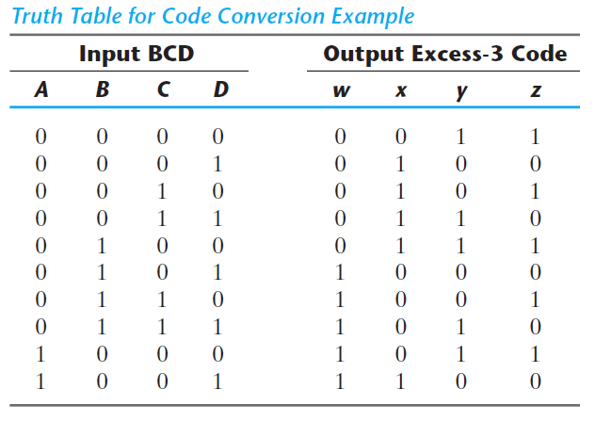
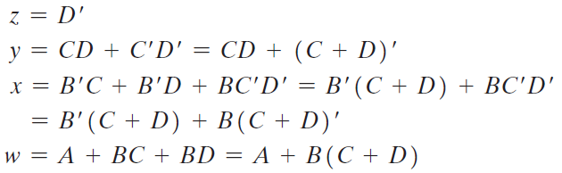

Slide 5
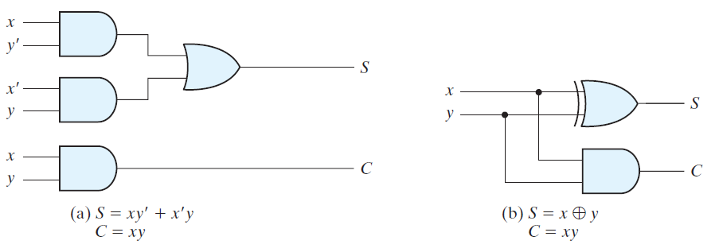
BINARY ADDER– SUBTRACTOR
A combinational circuit that performs the addition of two bits is called a half adder .
One that performs the addition of three bits (two significant bits and a previous carry) is a full adder .
Half Adder:

Slide 6
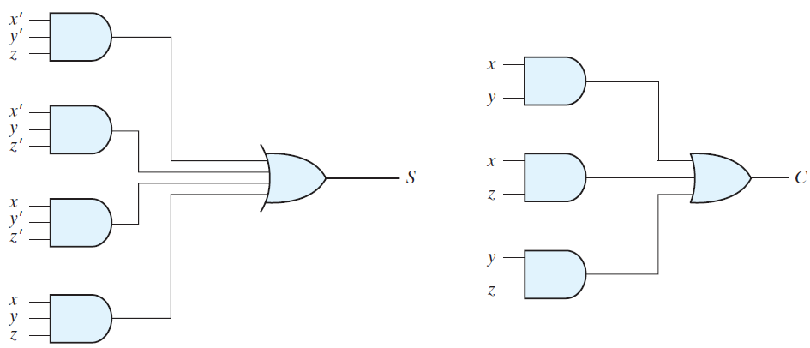
Full Adder:
A full adder is a combinational circuit that forms the arithmetic sum of three bits. It consists of three inputs and two outputs.
Figure: Implementation of full adder in sum-of-products form

Slide 7
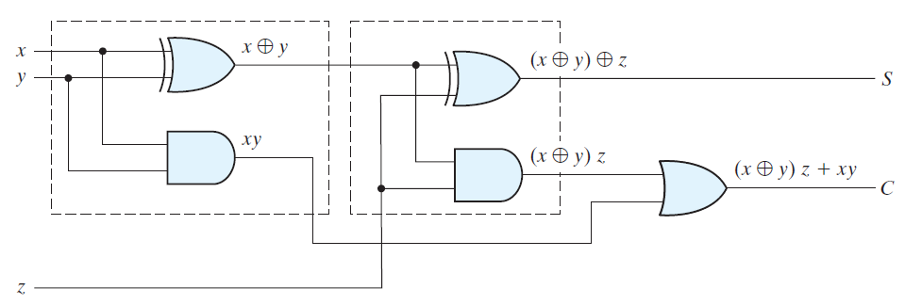
Figure: Implementation of full adder with two half adders and an OR gate.
Binary Adder:
A binary adder is a digital circuit that produces the arithmetic sum of two binary numbers. It can be constructed with full adders connected in cascade, with the output carry from each full adder connected to the input carry of the next full adder in the chain.

Slide 8
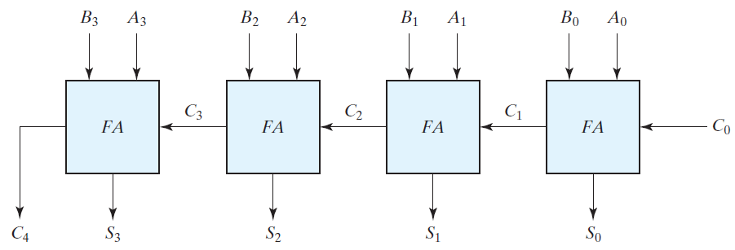
Following figure shows the interconnection of four full-adder (FA) circuits to provide a four-bit binary ripple carry adder.
FIGURE: Four-bit adder
Addition of n-bit numbers requires a chain of n full adders or a chain of one-half adder and (n – 1) full adders.
An n -bit adder requires n full adders, with each output carry connected to the input carry of the next higher order full adder (Ripple carry).

Slide 9
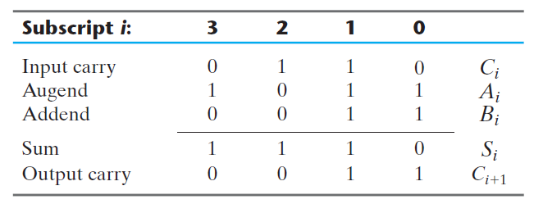
To demonstrate with a specific example, consider the two binary numbers A = 1011 and B = 0011. Their sum S = 1110 is formed with the four-bit adder as follows:
The four-bit adder is a typical example of a standard component. It can be used in many applications involving arithmetic operations.
Observe that the design of this circuit by the classical method would require a truth table with 512 entries, since there are nine inputs to the circuit.

Slide 10
Carry Propagation:
The addition of two binary numbers in parallel implies that all the bits of the augend and addend are available for computation at the same time.
As in any combinational circuit, the signal must propagate through the gates before the correct output sum is available in the output terminals.
The total propagation time is equal to the propagation delay of a typical gate, times the number of gate levels in the circuit.
The number of gate levels for the carry propagation can be found from the circuit of the full adder. The circuit is redrawn with different labels in the following Fig. for convenience.
The signals at Pi and Gi settle to their steady-state values after they propagate through their respective gates.

Slide 11
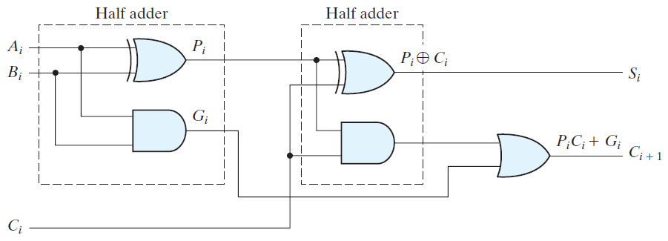
FIGURE: Full adder with P and G shown
These two signals are common to all half adders and depend on only the input augend and addend bits. The signal from the input carry Ci to the output carry Ci+1 propagates through an AND gate and an OR gate, which constitute two gate levels.
If there are four full adders in the adder, the output carry C4 would have 2 * 4 = 8 gate levels from C0 to C4. For an n -bit adder, there are 2n gate levels for the carry to propagate from input to output.

Slide 12

The carry propagation time is an important attribute of the adder because it limits the speed with which two numbers are added.
An obvious solution for reducing the carry propagation delay time is to employ faster gates with reduced delays. However, physical circuits have a limit to their capability.
Another solution is to increase the complexity of the equipment in such a way that the carry delay time is reduced.
There are several techniques for reducing the carry propagation time in a parallel adder.
The most widely used technique employs the principle of carry look ahead logic.
With reference to above circuit, if we define two new binary variables.

Slide 13



The output sum and carry can respectively be expressed as
Gi is called a carry generate , and it produces a carry of 1 when both Ai and Bi are 1, regardless of the input carry Ci.
Pi is called a carry propagate , because it determines whether a carry into stage i will propagate into stage i + 1.
Let us write the Boolean functions for the carry outputs of each stage and substitute the value of each Ci from the previous equations:

Slide 14
The three Boolean functions for C1, C2, and C3 are implemented in the carry lookahead generator shown in the following Fig.
Note that this circuit can add in less time because C3 does not have to wait for C2 and C1 to propagate; in fact, C3 is propagated at the same time as C1 and C2.
This gain in speed of operation is achieved at the expense of additional complexity (hardware).

Slide 15
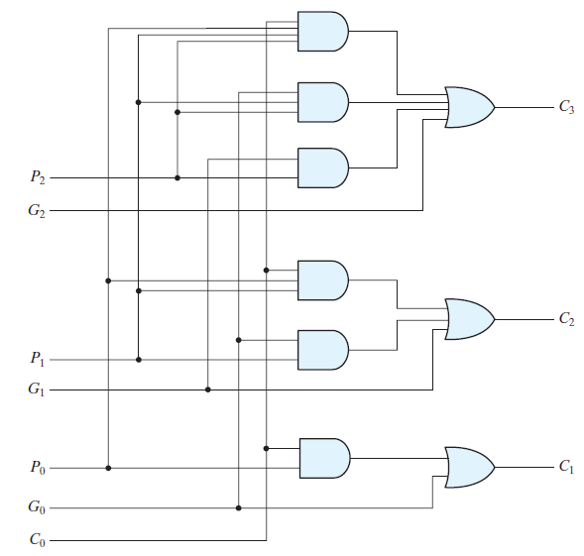
FIGURE: Logic diagram of carry lookahead generator

Slide 16
The construction of a four-bit adder with a carry lookahead scheme is shown in the following Fig.
Each sum output requires two exclusive-OR gates. The output of the first exclusive-OR gate generates the Pi variable, and the AND gate generates the Gi variable.
The carries are propagated through the carry lookahead generator and applied as inputs to the second exclusive-OR gate.
All output carries are generated after a delay through two levels of gates.
Thus, outputs S1 through S3 have equal propagation delay times.

Slide 17
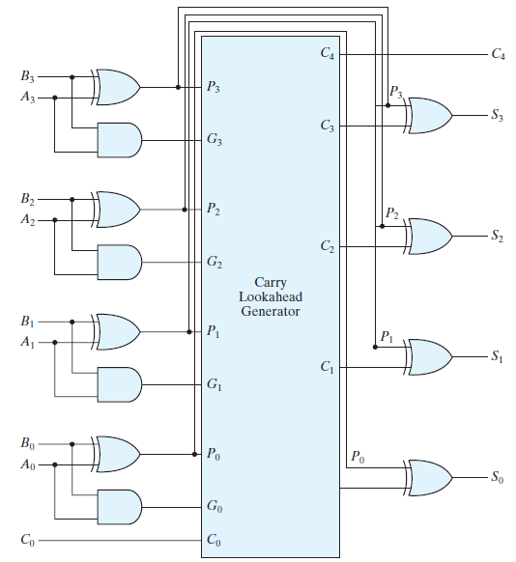
FIGURE: Four-bit adder with carry lookahead

Slide 18
Binary Subtractor:
The subtraction of unsigned binary numbers can be done most conveniently by means of complements.
The addition and subtraction operations can be combined into one circuit with one common binary adder by including an exclusive-OR gate with each full adder.
A four-bit adder–subtractor circuit is shown in the following Fig. The mode input M controls the operation. When M = 0, the circuit is an adder, and when M = 1, the circuit becomes a subtractor.
It is worth noting that binary numbers in the signed-complement system are added and subtracted by the same basic addition and subtraction rules as are unsigned numbers.

Slide 19
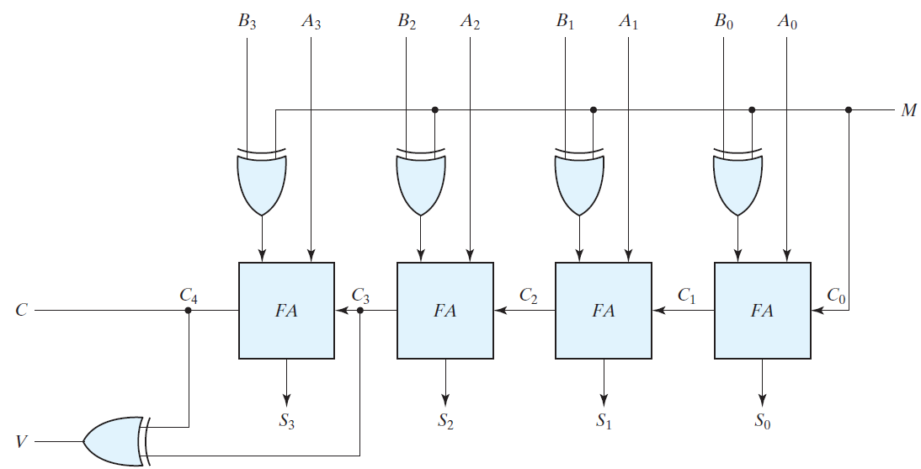
The user or programmer must interpret the results of such addition or subtraction differently, depending on whether it is assumed that the numbers are signed or unsigned.
FIGURE: Four-bit adder–subtractor (with overflow detection)

Slide 20
Overflow:
The detection of an overflow after the addition of two binary numbers depends on whether the numbers are considered to be signed or unsigned.
When two unsigned numbers are added, an overflow is detected from the end carry out of the most significant position.
In the case of signed numbers, two details are important: the leftmost bit always represents the sign, and negative numbers are in 2’s-complement form.
When two signed numbers are added, the sign bit is treated as part of the number and the end carry does not indicate an overflow.
An overflow may occur if the two numbers added are both positive or both negative.

Slide 21
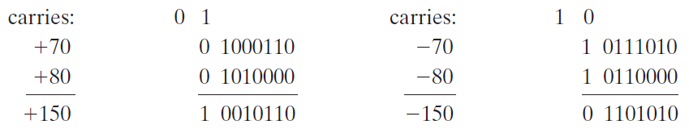
Two signed binary numbers, +70 and +80, are stored in two eight-bit registers. Since the sum of the two numbers is +150, it exceeds the capacity of an eight-bit register. This is also true for -70 and -80. The two additions in binary are shown next, together with the last two carries:
Note that the eight-bit result that should have been positive has a negative sign bit (i.e., the eighth bit) and the eight-bit result that should have been negative has a positive sign bit. If, however, the carry out of the sign bit position is taken as the sign bit of the result, then the nine-bit answer so obtained will be correct. But since the answer cannot be accommodated within eight bits, we say that an overflow has occurred.

Slide 22
An overflow condition can be detected by observing the carry into the sign bit position and the carry out of the sign bit position.
If these two carries are not equal, an overflow has occurred. If the two carries are applied to an exclusive-OR gate, an overflow is detected when the output of the gate is equal to 1.
The binary adder–subtractor circuit with outputs C and V is shown in the following Fig.
If the two binary numbers are considered to be unsigned, then the C bit detects a carry after addition or a borrow after subtraction. If the numbers are considered to be signed, then the V bit detects an overflow.
If V = 0 after an addition or subtraction, then no overflow occurred and the n -bit result is correct. If V = 1, then the result of the operation contains n + 1 bits, but only the rightmost n bits of the number fit in the space available, so an overflow has occurred. The (n + 1)th bit is the actual sign and has been shifted out of position.

Slide 23
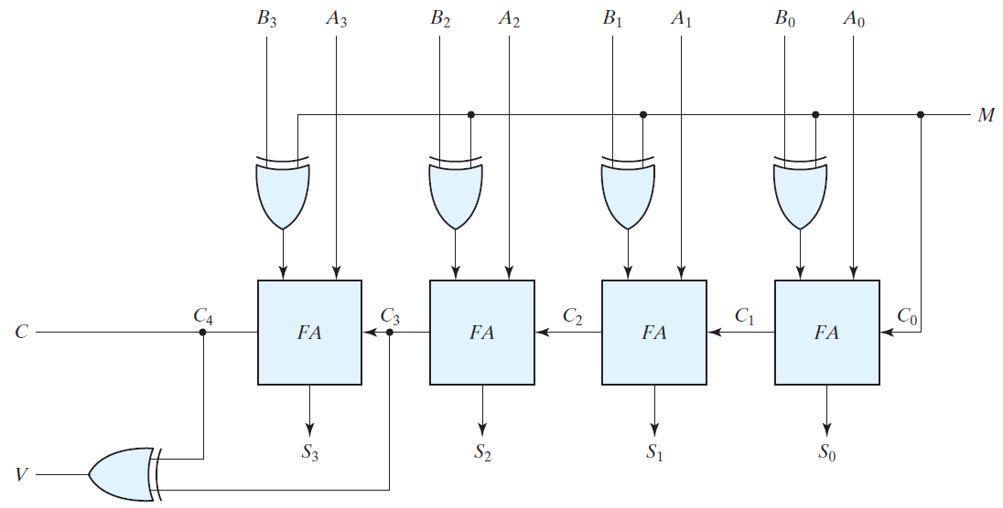
FIGURE: Four-bit adder–subtractor (with overflow detection)

Slide 24
DECIMAL ADDER (BCD Adder):
Consider the arithmetic addition of two decimal digits in BCD, together with an input carry from a previous stage. Since each input digit does not exceed 9, the output sum cannot be greater than: 9 + 9 + 1 = 19.
Suppose we apply two BCD digits to a four-bit binary adder. The adder will form the sum in binary and produce a result that ranges from 0 through 19. These binary numbers are listed in the following Table.
The problem is to find a rule by which the binary sum is converted to the correct BCD digit representation of the number in the BCD sum.
The logic circuit that detects the necessary correction can be derived from the entries in the table. It is obvious that a correction is needed when the binary sum has an output carry K = 1.

Slide 25
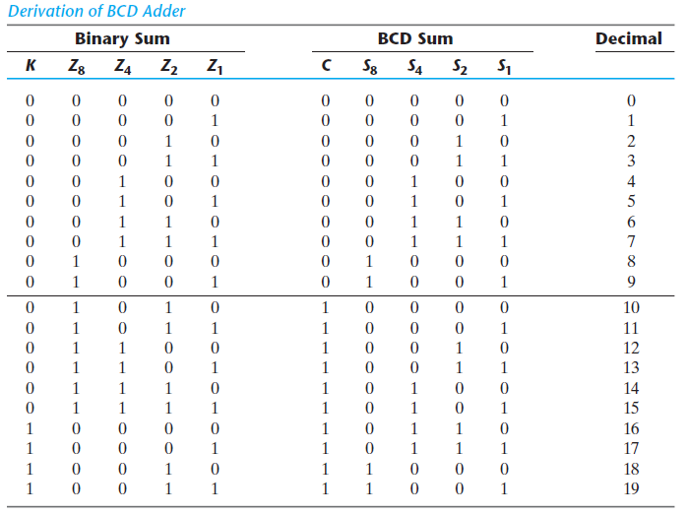

Slide 26

The condition for a correction and an output carry can be expressed by the Boolean function:
When C = 1, it is necessary to add 0110 to the binary sum and provide an output carry for the next stage.
A BCD adder that adds two BCD digits and produces a sum digit in BCD is shown In the following Fig.
The two decimal digits, together with the input carry, are first added in the top four-bit adder to produce the binary sum. When the output carry is equal to 0, nothing is added to the binary sum. When it is equal to 1, binary 0110 is added to the binary sum through the bottom four-bit adder.
The output carry generated from the bottom adder can be ignored, since it supplies information already available at the output carry terminal.

Slide 27
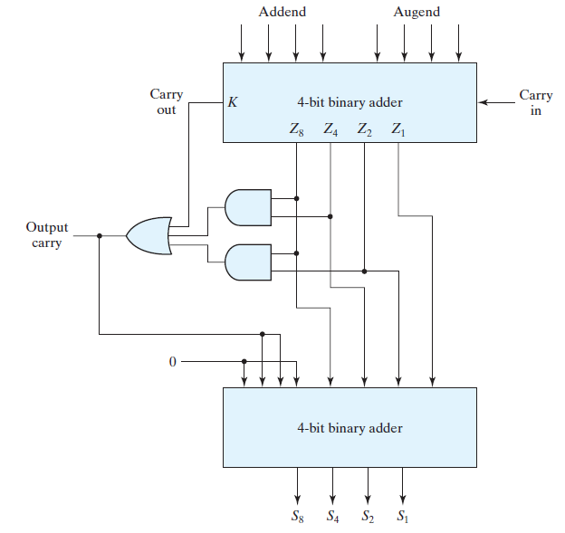
FIGURE: Block diagram of a BCD adder

Slide 28

MAGNITUDE COMPARATOR:
A magnitude comparator is a combinational circuit that compares two numbers A and B and determines their relative
magnitudes. The outcome of the comparison is specified by three binary variables that indicate whether A > B, A = B, or
A < B.
4-bit Comparator:
In a 4-bit comparator the condition of A = B can be possible in the following cases:
The two numbers are equal if all pairs of significant digits are equal: A3 = B3, A2 = B2, A1 = B1, and A0 = B0. When the numbers are binary, the digits are either 1 or 0, and the equality of each pair of bits can be expressed logically with an exclusive-NOR function as:

Slide 29
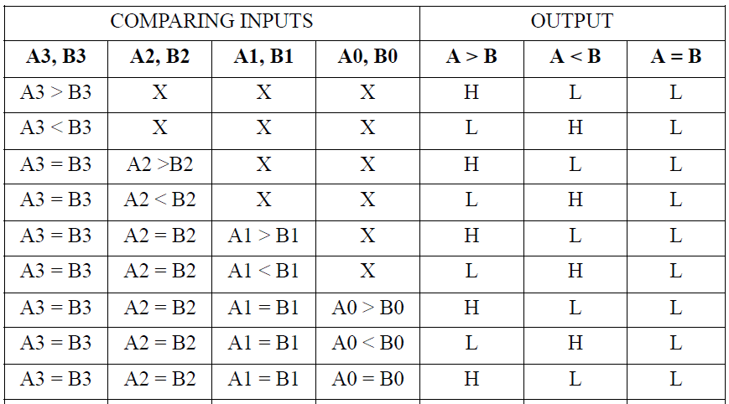
Truth Table:

Slide 30
In a 4-bit comparator the condition of A>B can be possible in the following four cases:
If A3 = 1 and B3 = 0
If A3 = B3 and A2 = 1 and B2 = 0
If A3 = B3, A2 = B2 and A1 = 1 and B1 = 0
If A3 = B3, A2 = B2, A1 = B1 and A0 = 1 and B0 = 0.
Similarly the condition for A<B can be possible in the following four cases:
If A3 = 0 and B3 = 1
If A3 = B3 and A2 = 0 and B2 = 1
If A3 = B3, A2 = B2 and A1 = 0 and B1 = 1
If A3 = B3, A2 = B2, A1 = B1 and A0 = 0 and B0 = 1
The condition of A=B is possible only when all the individual bits of one number exactly coincide with corresponding bits of another number.

Slide 31
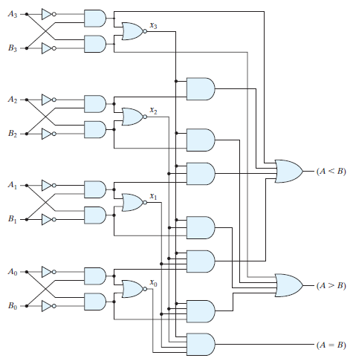
FIGURE: Four-bit magnitude comparator

